Slide 1

RPN Calculator
BY 19SW21

Slide 2
Identification Of Problem
When we do calculation, it requires a user to input a formula or calculation from left to right.it is easy for fewer operands but when it comes to complex calculation its become difficult
3*(4 + 5) / (4+50)+(5*7) …
RPN has no use for parentheses means it is faster and easier to calculate expressions, particularly the more complex ones, It does not need any parentheses as long as each operator has a fixed number of operands.

Slide 3
Why is Data Structure Necessary
Data Structures are used to organize and manipulate data in a sensible and particular way; a data structure is a collection of data values, the relationships among them, and the functions or operations that can be applied to the data.
In our problem we need arrange the data in postfix notation so that each operator is placed after its operand
Eg x y z + *.
Add your title
Add your title
Add your words here,according to your need to draw the text box size.
Add your words here,according to your need to draw the text box size.

Slide 4
Which Data Structure to use
Although the stack data structure is one of the simplest, it is essential in certain important Applications for its true meaning first in last out
Add your title
Add your title
Add your words here,according to your need to draw the text box size.
Add your words here,according to your need to draw the text box size.

Slide 5
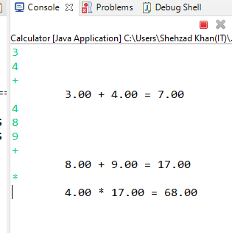
Code
Scanner in = new Scanner(System.in);
while (true)
{
String input = in.nextLine();
Char ch = input.charAt(0);
if (ch == '+' || ch == '-' || ch == '*' || ch == '/')
{
    double y = Double.parseDouble(stack.pop());
    double x = Double.parseDouble(stack.pop());
    double z = 0;
    switch (ch)
    {
    case '+': z = x + y; break;
    case '-': z = x - y; break;
    case '*': z = x * y; break;
    case '/': z = x / y;
    }
    System.out.printf("\t%.2f %c %.2f = %.2f%n", x, ch, y, z);
    stack.push(new Double(z).toString();
    }
    else if (ch == 'q' || ch == 'Q')
    {
    return;
    }
    else
    {
    stack.push(input);
    }
Add your title
Add your title
Add your words here,according to your need to draw the text box size.
Add your words here,according to your need to draw the text box size.

Slide 6
Thank You

